Slide 1
Warmly invites you to MEGA2019 “Make Environment Great Again”

Slide 2
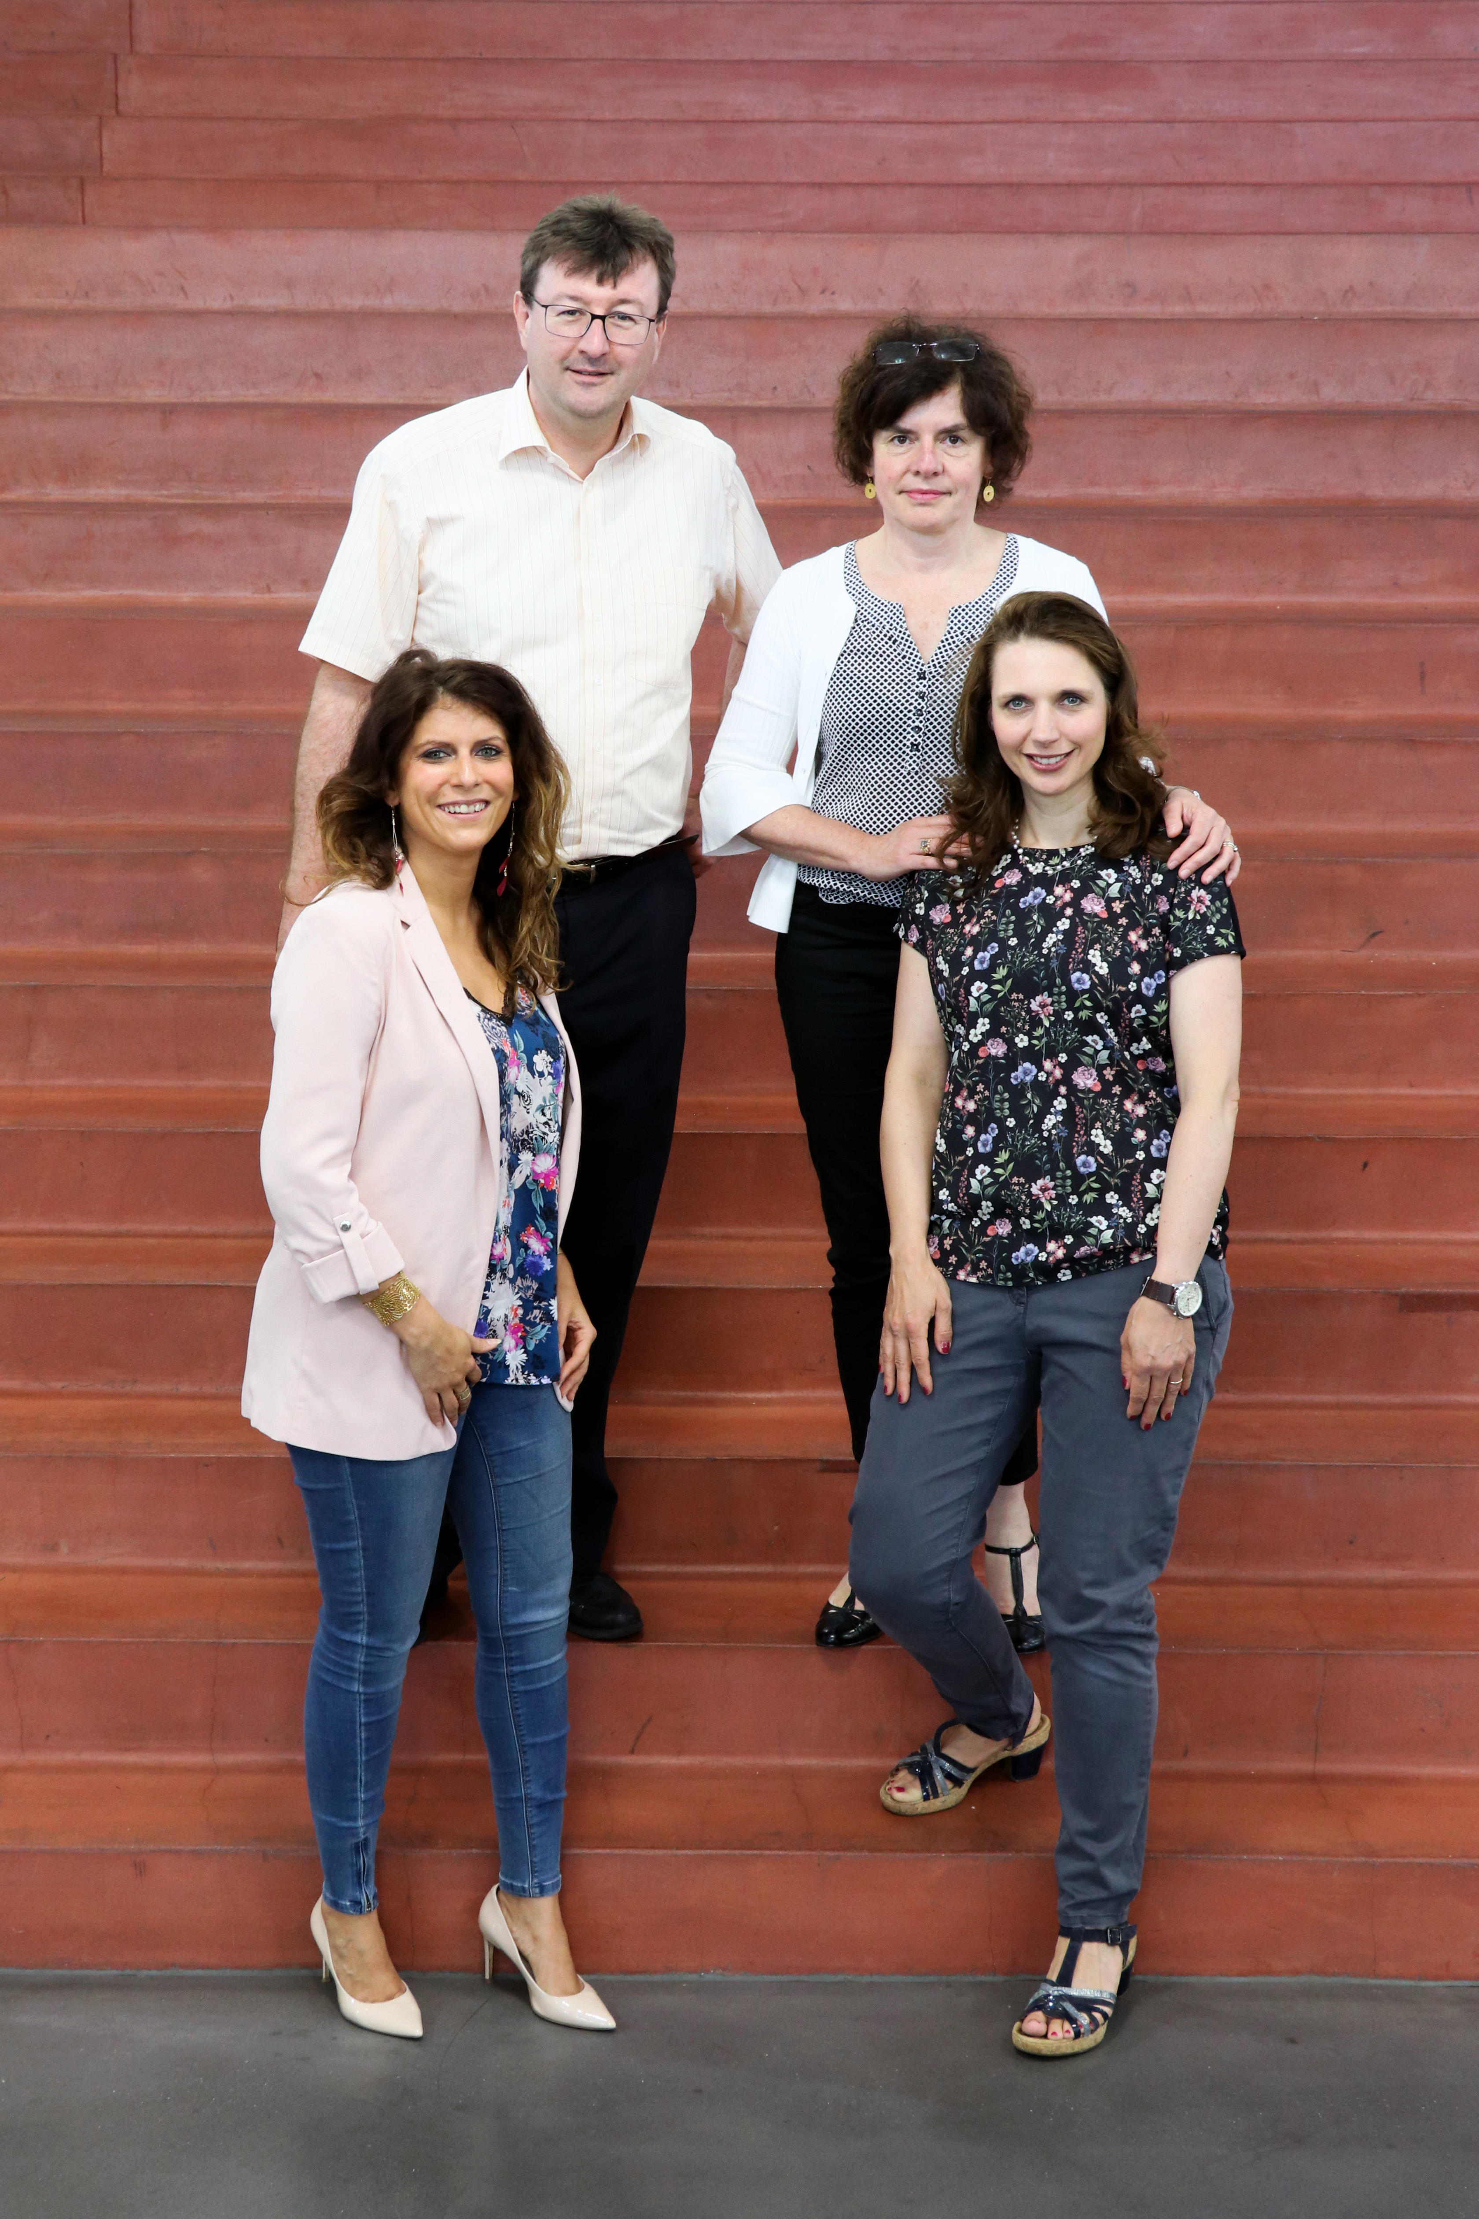
Jean-Claude Hemmer headmaster
Claire Simon deputy head
Sandra Galli teacher
Sandra Droste correspondent

Slide 3
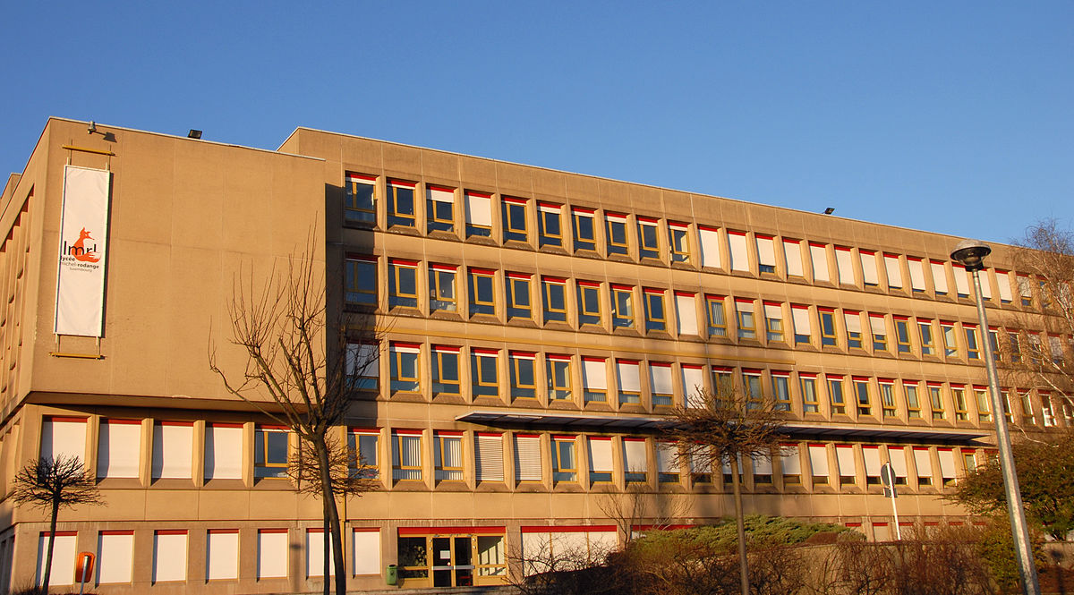
Welcome
“Old school”

Slide 4
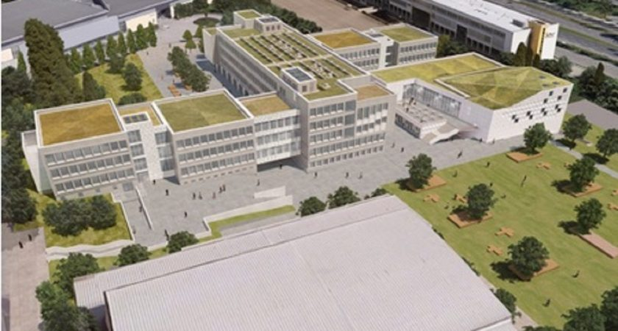
Welcome
New building 2021

Slide 5
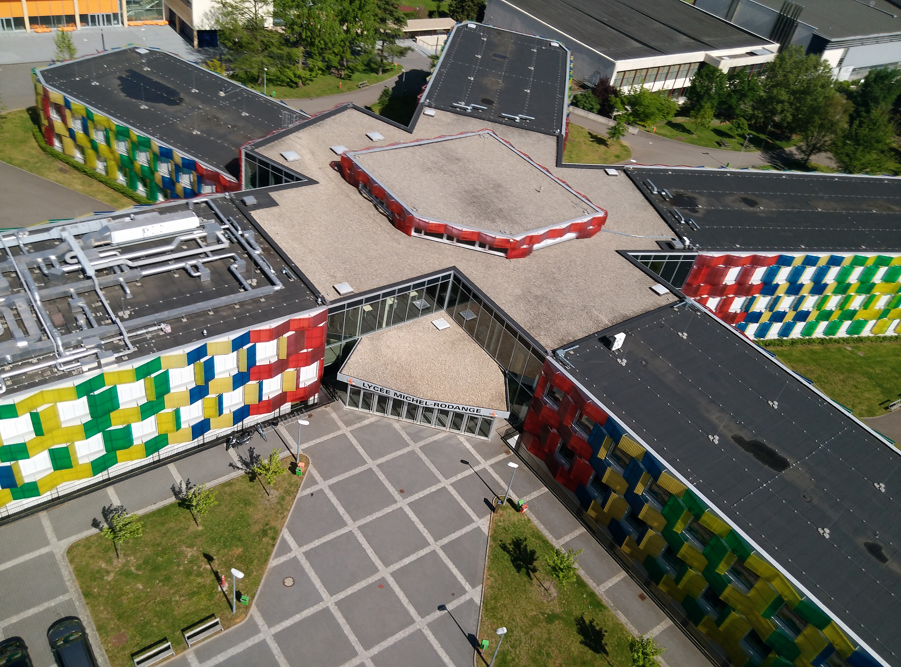
Welcome
2017-2021 in the “Flower”

Slide 6
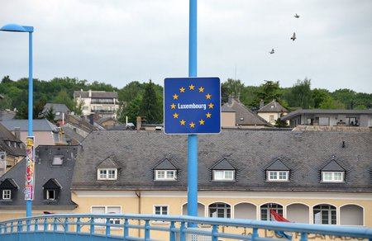
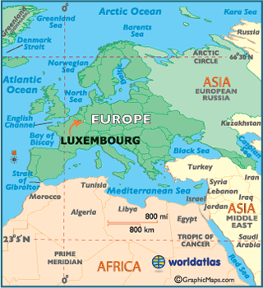
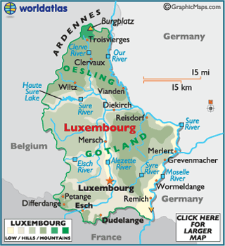
Welcome to Luxembourg

Slide 7
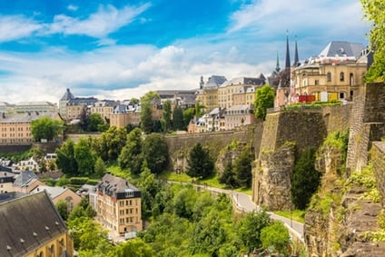
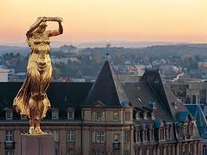
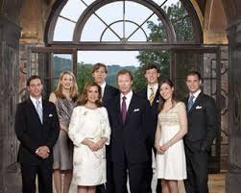
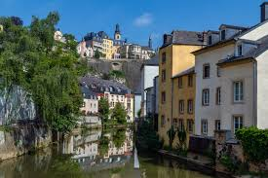
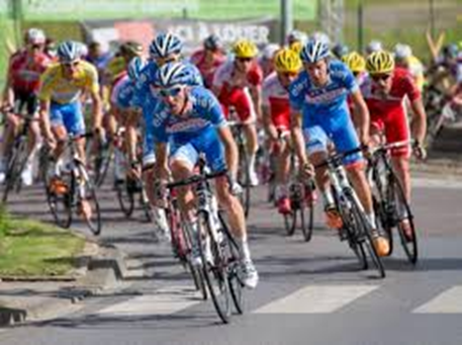
Welcome to Luxembourg

Slide 8
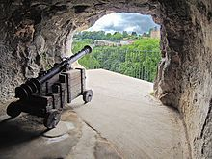
Luxembourg UNESCO World Heritage

Slide 9
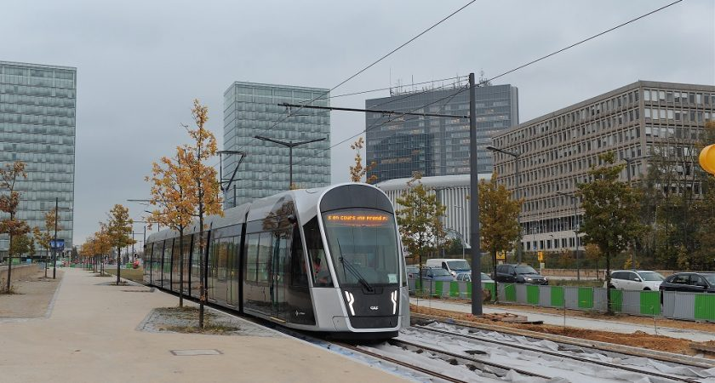
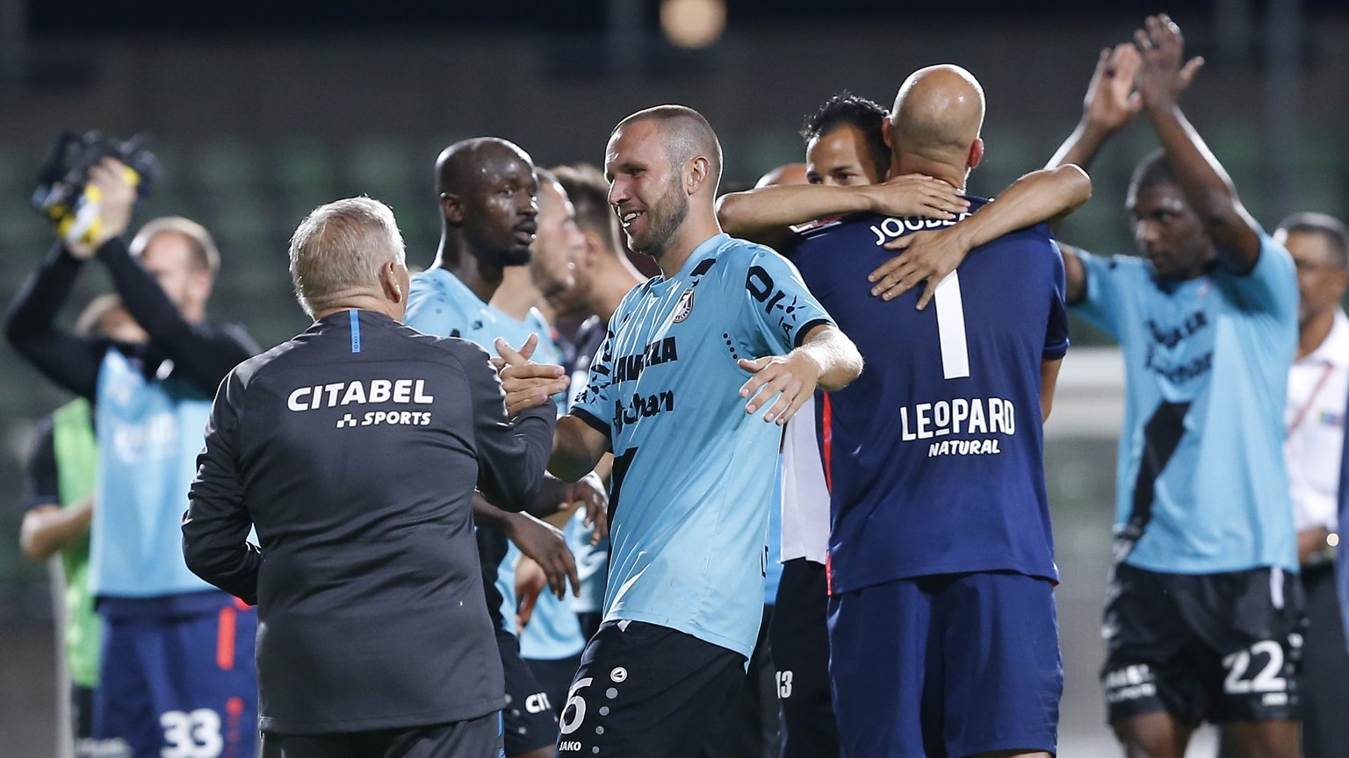
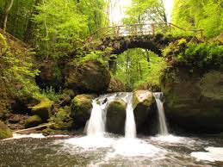
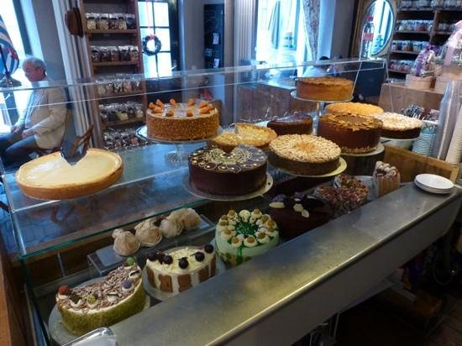
Welcome to Luxembourg

Slide 10
How to get to Luxembourg
By plane
Luxembourg Airport
Connections to all major cities
Brussels South Charleroi Airport or Frankfurt Hahn airport
Low cost airlines
Ryanair
By bus
FLIBCO offers shuttles from Charleroi and Frankfurt to Luxembourg
Destination in Luxembourg LUXEMBOURG - P&R Bouillon
Website: Flibco.com
By car
Coming from Belgium
Coming from France
Coming from Germany
By train
You may also walk or bike
In this case, I guess, you don’t need any help

Slide 11
Topic MEGA Make Environment Great Again
+
Make students and staff more
aware of and active for
a sustainable environment
in both every-day school life
as well as in society

Slide 12
When: 10th – 14th November 2019
Sunday 10th Nov. arrival day
Monday 11th –Wednesday 13th Nov. workshops
Thursday 14th Nov. departure day

Slide 13
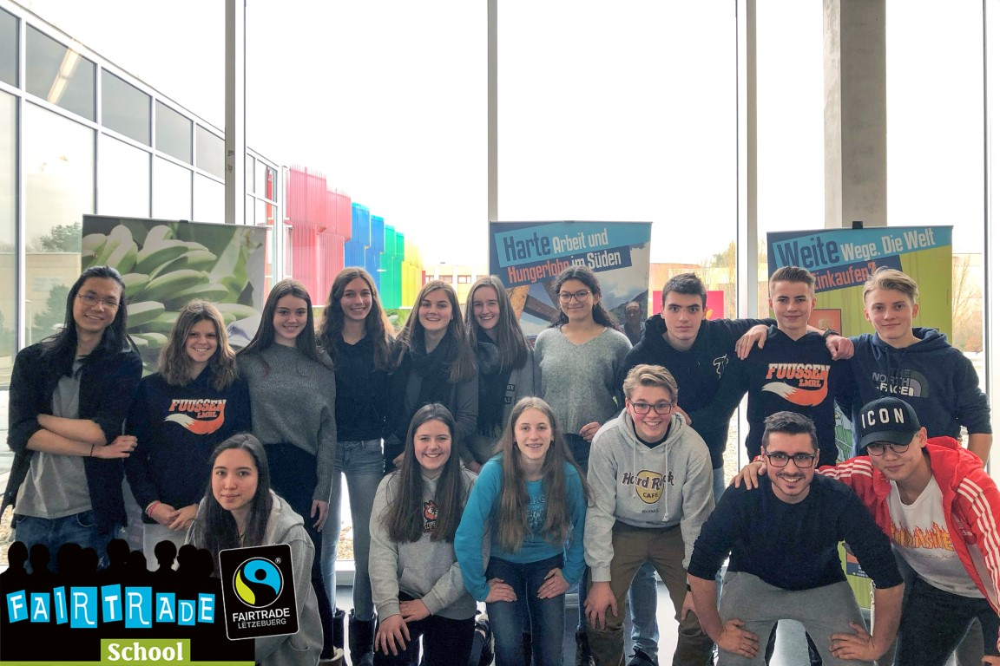
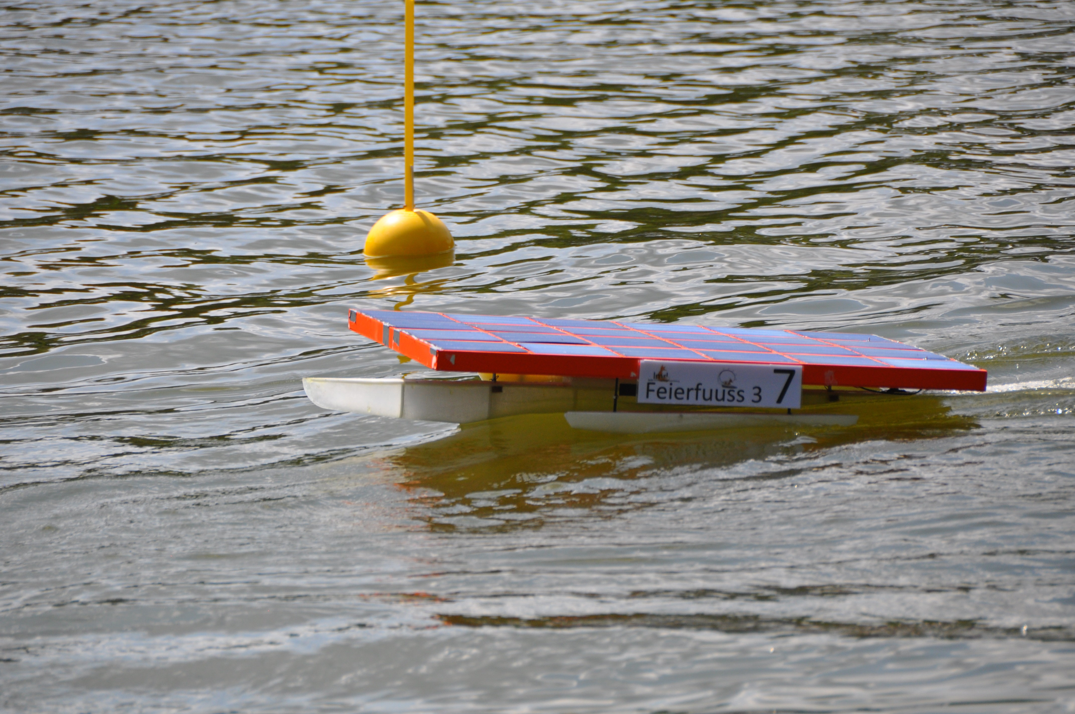
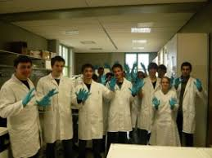
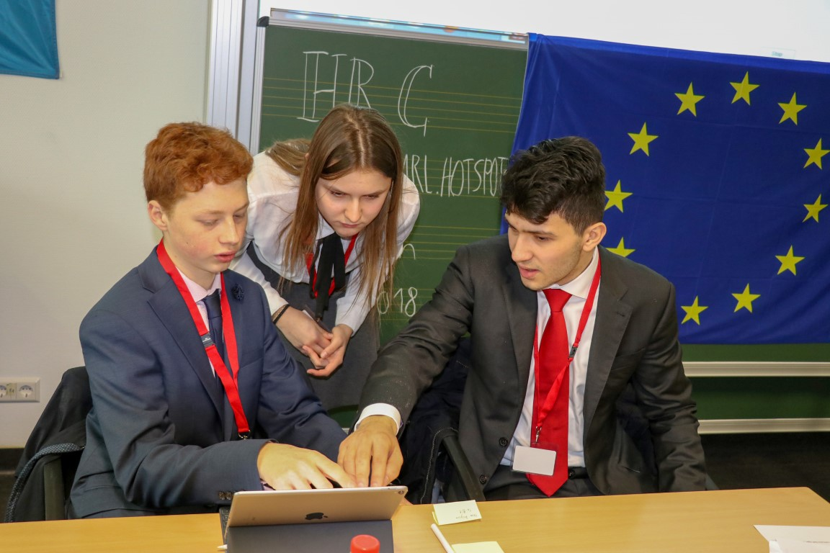
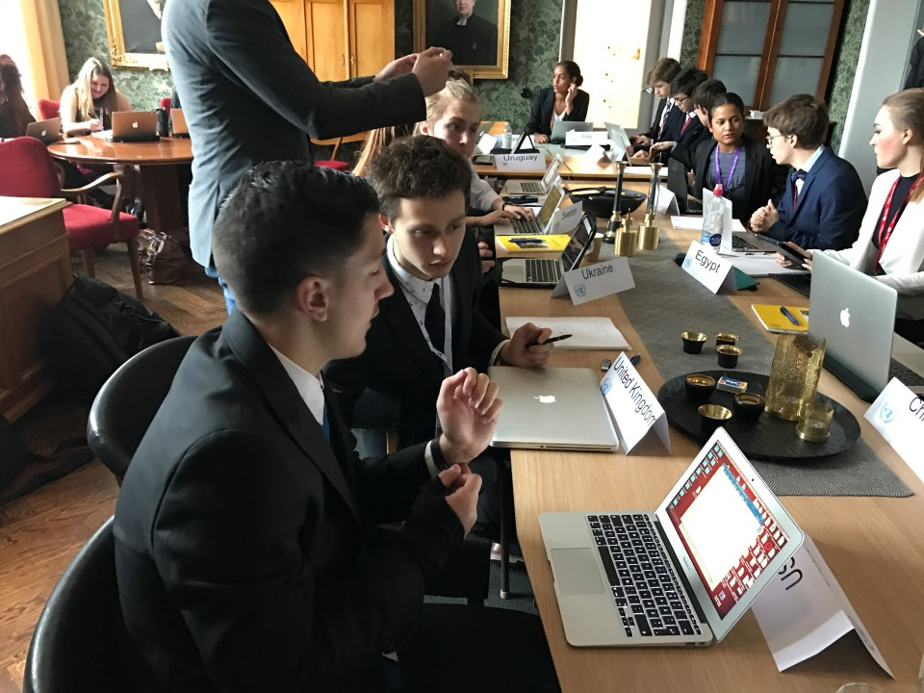
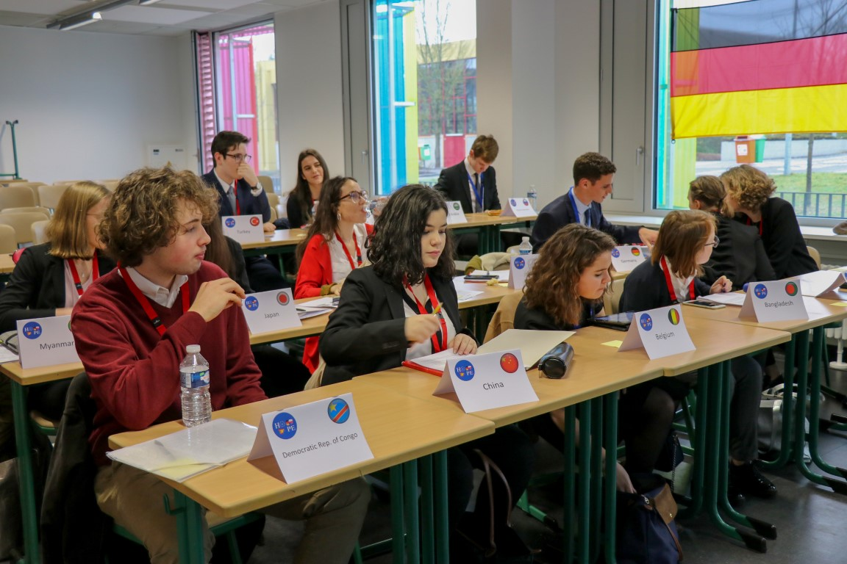
Topic MEGA Make Environment Great Again
Every-day school life: Sustainability projects workshops
Society: Debating a Model United Nation topic on Environment

Slide 14
Who to bring
2 students aged 16-18 with the following qualities:
eloquent,
open-minded,
interested in environment issues in politics AND at school
2-3 members of staff

Slide 15
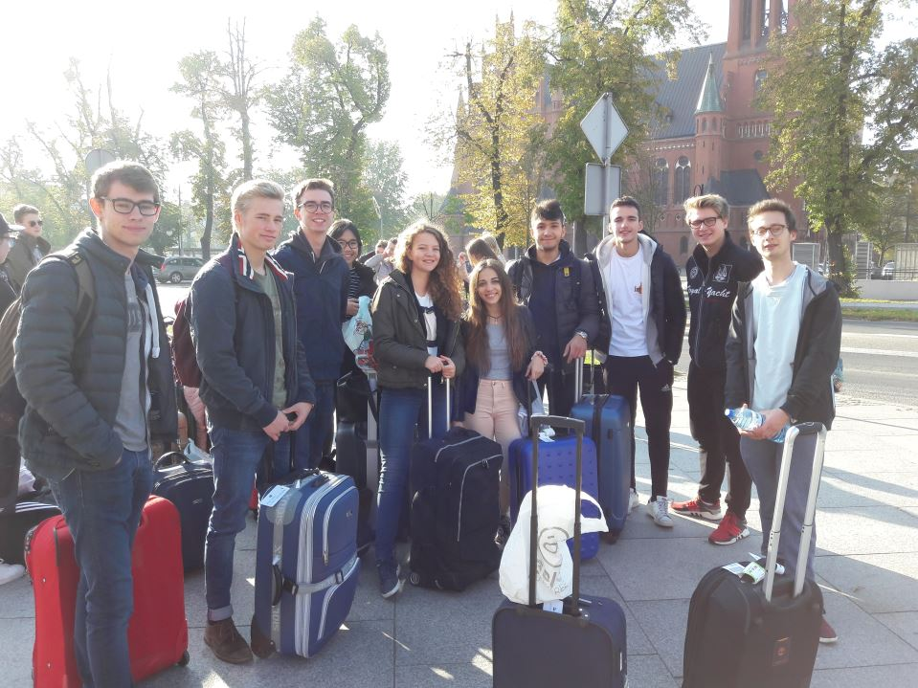
Accomodation: Students in host families

Slide 16
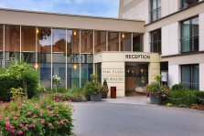
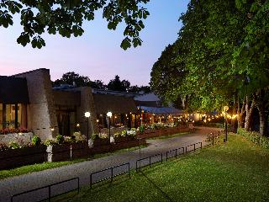
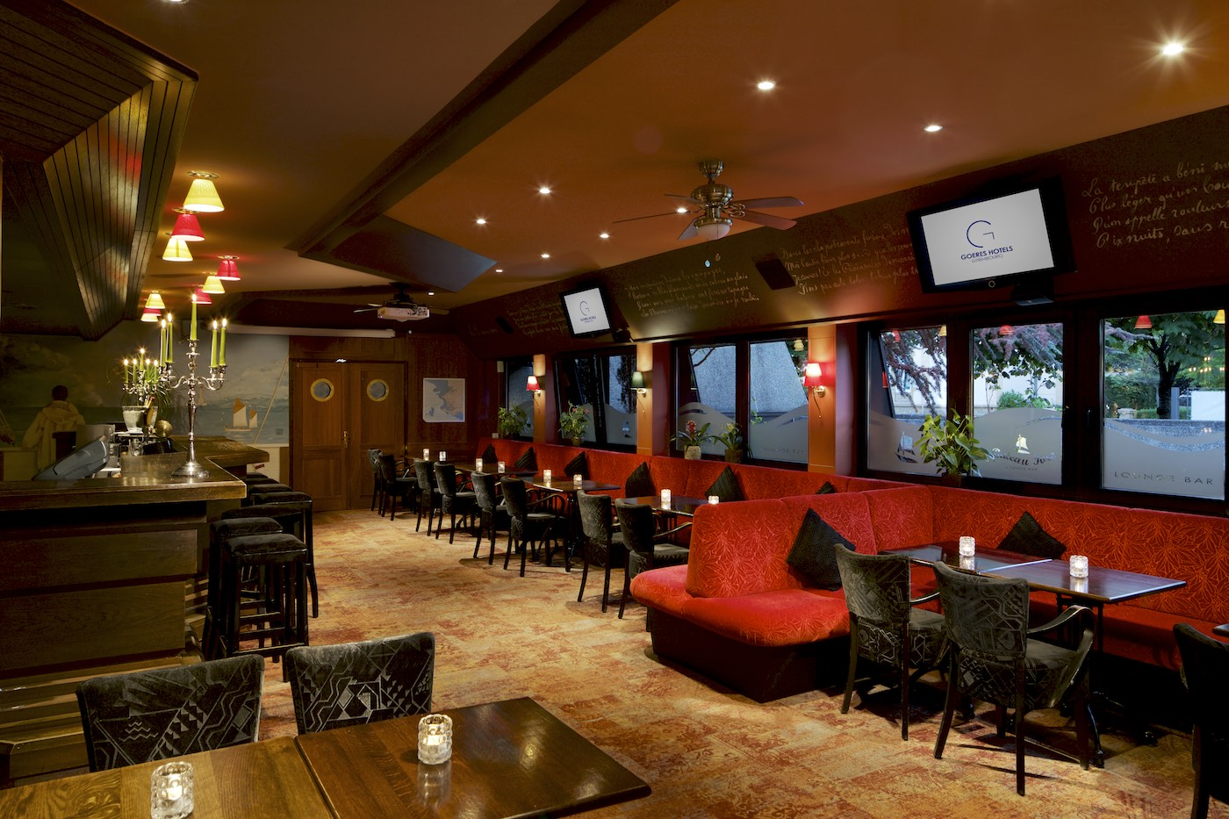
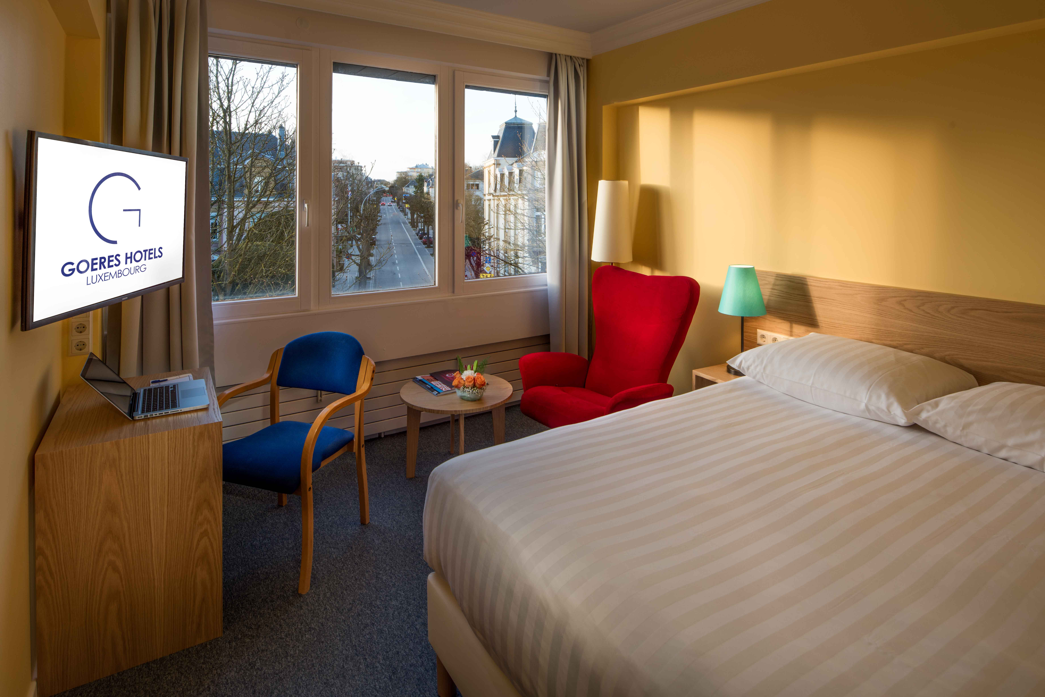
Accommodation: teachers
Hotel Parc Belle-Vue
5 Avenue Marie-Thérèse, 2132 Luxembourg Telefon: 45 61 41 1
https://www.goereshotels.com/belle-vue-en/

Slide 17
We are looking forward to hosting old and new friends from all over Europe
at MEGA2019

